Slide 1
Testing
Elvedin Selimoski

Slide 2
Why testing is worth your time
Unit testing
Mockito

Slide 3

Why should you test your app?
Find and fix issues early
Less costly
Takes less effort
Costs to fix bugs
increases with time
Cost to Fix
Catch bugs early!
$1000
$100
$10
$1
Specification
Design
Code
QA
Release
Discovery Time

Slide 4
Types of testing
Local unit tests
Instrumented tests

Slide 5
Test-Driven Development (TDD)
Define a test case for a requirement
Write tests that assert all conditions of the test case
Write code against the test
Iterate on and refactor code until it passes the test
Repeat until all requirements have test cases, all tests pass, and all functionality has been implemented

Slide 6
Tests in your project
Android Studio creates three source sets for your project
main—code and resources
(test)—local unit tests
(androidTest)—instrumented tests

Slide 7
Local Unit Tests
Elvedin Selimoski

Slide 8
Unit tests
Smallest testable parts of your program
Isolate each component and demonstrate the individual parts are correct
Java Method tests
Results
Inputs
Java method
Graceful Failure

Slide 9
Local unit tests in JUnit
Compiled and run entirely on your local machine with the Java Virtual Machine (JVM)
Use to test the parts of your app (such as the internal logic):
  If you don't need access to Android framework or device/emulator
  If you can create fake (mock) objects that pretend to behave like the framework equivalents
Unit tests are written with JUnit, a common unit testing framework for Java.

Slide 10
Local unit tests in your project
Tests are in the same package as the associated application class
Only org.junit imported — no Android classes
Project path for test classes: .../module-name/src/test/java/

Slide 11
Imports for JUnit
// Annotations
import org.junit.Before;
import org.junit.Test;
import org.junit.runner.RunWith;
// Basic JUnit4 test runner
import org.junit.runners.JUnit4;
// assertThat method
import static org.junit.Assert.assertThat;

Slide 12
Testing class
/**
* JUnit4 unit tests for the calculator logic.
* These are local unit tests; no device needed
*/
@RunWith(JUnit4.class) // Specify the test runner
public class CalculatorTest { // Name it what you are testing
}

Slide 13
ExampleTest
/
**
* Test for simple addition.
* Each test is identified by a @Test annotation.
*/
@Test
public void addTwoNumbers() {
double resultAdd = mCalculator.add(1d, 1d);
assertThat(resultAdd, is(equalTo(2d)));
}

Slide 14
@Test Annotation
Tells JUnit this method is a test method (JUnit 4)
Information to the test runner
Not necessary anymore to prefix test methods with "test"

Slide 15
setUp() method
/**
* Set up the environment for testing
*/
@Before
public void setUp() {
mCalculator = new Calculator();
}
Sets up environment for testing
Initialize variables and objects used in multiple tests

Slide 16
tearDown() method
/**
* Release external resources
*/
@After
public void tearDown() {
....
}
Frees resources

Slide 17
Running tests in Android Studio
Elvedin Selimoski

Slide 18

Starting a test run
Right-click test class and select
Run 'app_name' test
Right-click test package and select
Run tests in 'package'

Slide 19
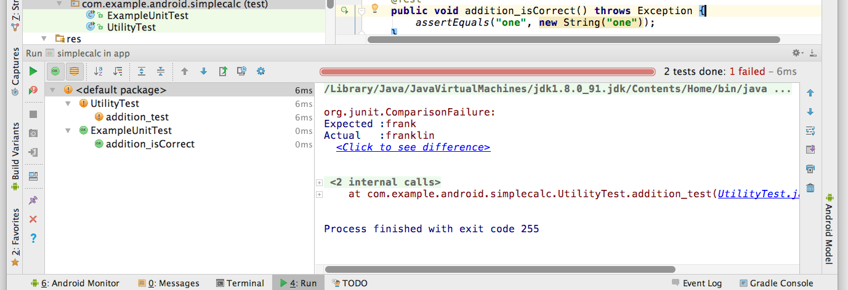
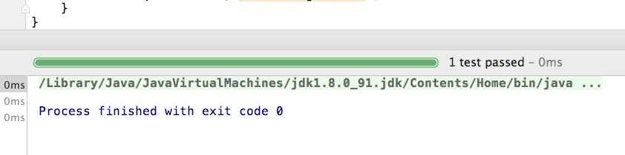
Passing and failing
Fail
Fail
Pass
Result details

Slide 20
Testing floating point results
Elvedin Selimoski

Slide 21
Testing floating point
Be careful with floating point tests
Recall from basic computer science:
  Floating point arithmetic is not accurate in binary

Slide 22
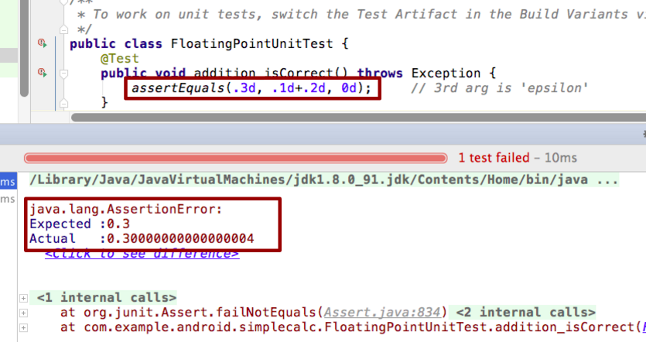
Test fails with floating point numbers

Slide 23
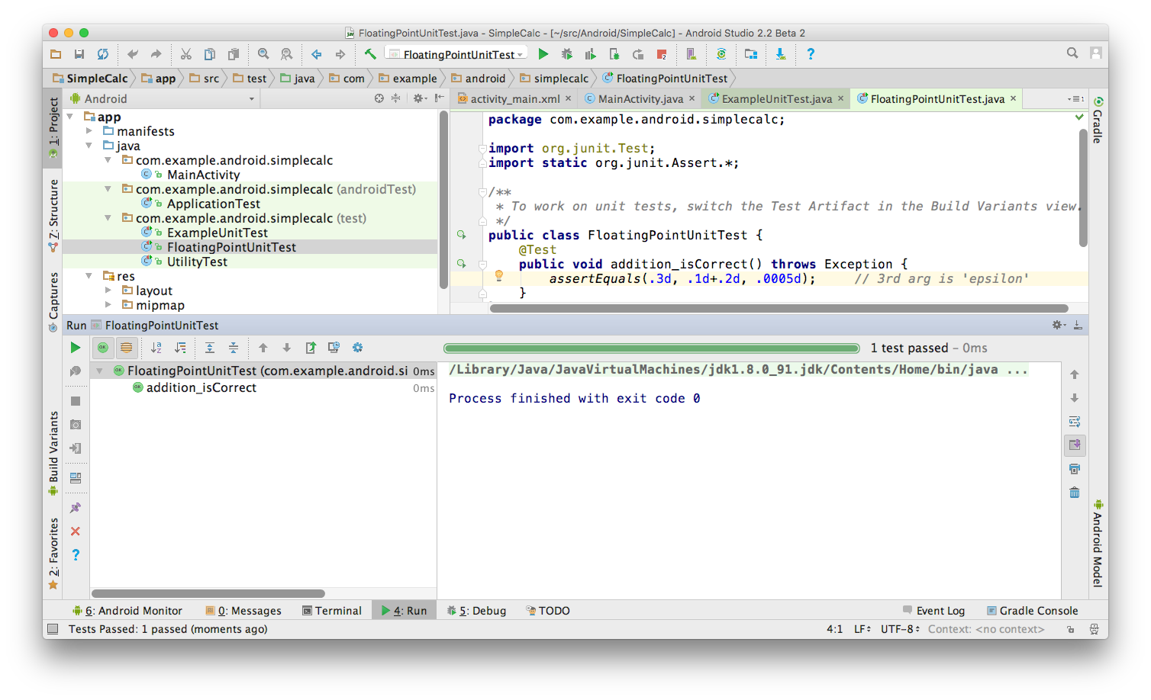
Fix test with floating point numbers
They are the same within .0005 in this test

Slide 24
Mockito
Elvedin Selimoski

Slide 25
What is mock/mocking?
Mock - something made as an imitation (from dictionary)
„An object under test may have dependencies on other (complex) objects. To isolate the behavior of the object you want to replace the other objects by mocks that simulate the behavior of the real objects.“ - SO Answer

Slide 26
Why drink it?
Mocks concrete classes as well as interfaces
Little annotation syntax sugar - @Mock
Verification errors are clean - click on stack trace to see failed verification in test; click on exception's cause to navigate to actual interaction in code. Stack trace is always clean.
Allows flexible verification in order (e.g: verify in order what you want, not every single interaction)
Supports exact-number-of-times and at-least-once verification
Flexible verification or stubbing using argument matchers (anyObject(), anyString() or refEq() for reflection-based equality matching)
Allows creating custom argument matchers or using existing hamcrest matchers

Slide 27
How do I drink it?
Installation
repositories { jcenter() }
dependencies { testCompile "org.mockito:mockito-core:2.+" }
now you can verify interactions
import static org.mockito.Mockito.*;
// mock creation
List mockedList = mock(List.class);
// using mock object - it does not throw any "unexpected interaction" exception
mockedList.add("one");
mockedList.clear();
// selective, explicit, highly readable verification
verify(mockedList).add("one");
verify(mockedList).clear();

Slide 28
How do I drink it?
and stub method calls
// you can mock concrete classes, not only interfaces
LinkedList mockedList = mock(LinkedList.class);
// stubbing appears before the actual execution
when(mockedList.get(0)).thenReturn("first");
// the following prints "first"
System.out.println(mockedList.get(0));
// the following prints "null" because get(999) was not stubbed
System.out.println(mockedList.get(999)

Slide 29
Learn more
Getting Started with Testing
Best Practices for Testing
Building Local Unit Tests
JUnit 4 Home Page
JUnit 4 API Reference
Android Testing Codelab
Android Tools Protip: Test Size Annotations
Android Testing Support - Testing Patterns (video)

Slide 30
END

